Slide 1

Project: TA Report
IE04 Weekly Progress Report
2023/10/18
Team: Pikachu

Slide 2
Activities of Previous Week
Task | Member | Status | Work Hours
Project backlog phase | Youssef | 100% | 1:00
User case diagram | Merci | 100% | 0:30
Class diagram | Youssef | 100% | 1:00
Powerpoint preparation | Merci | 100% | 1:00
 |  | Total time: | 2:30

Slide 3
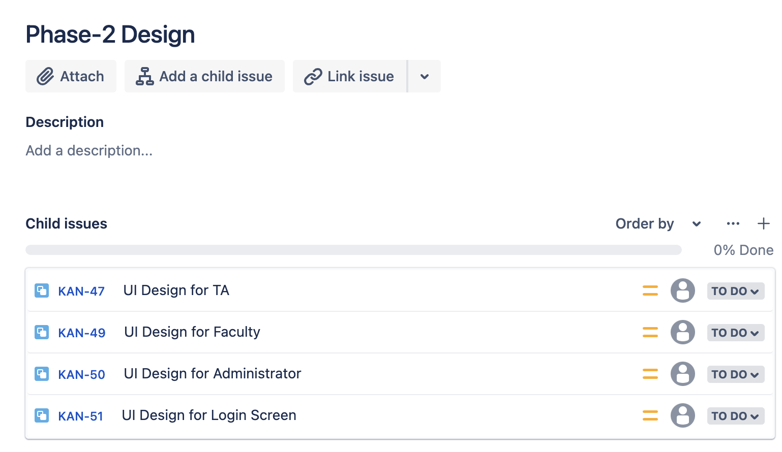
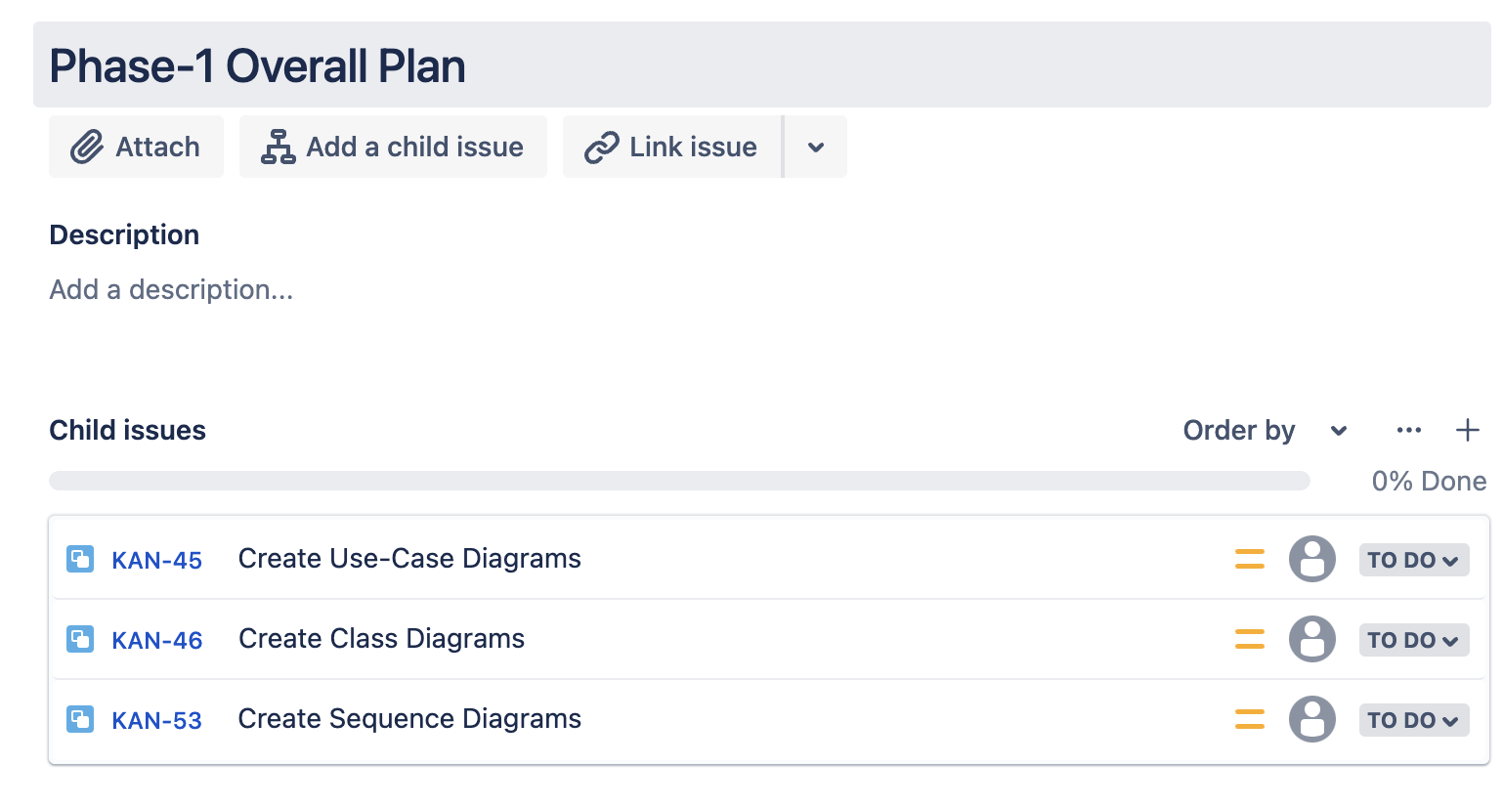
Phase Backlog

Slide 4
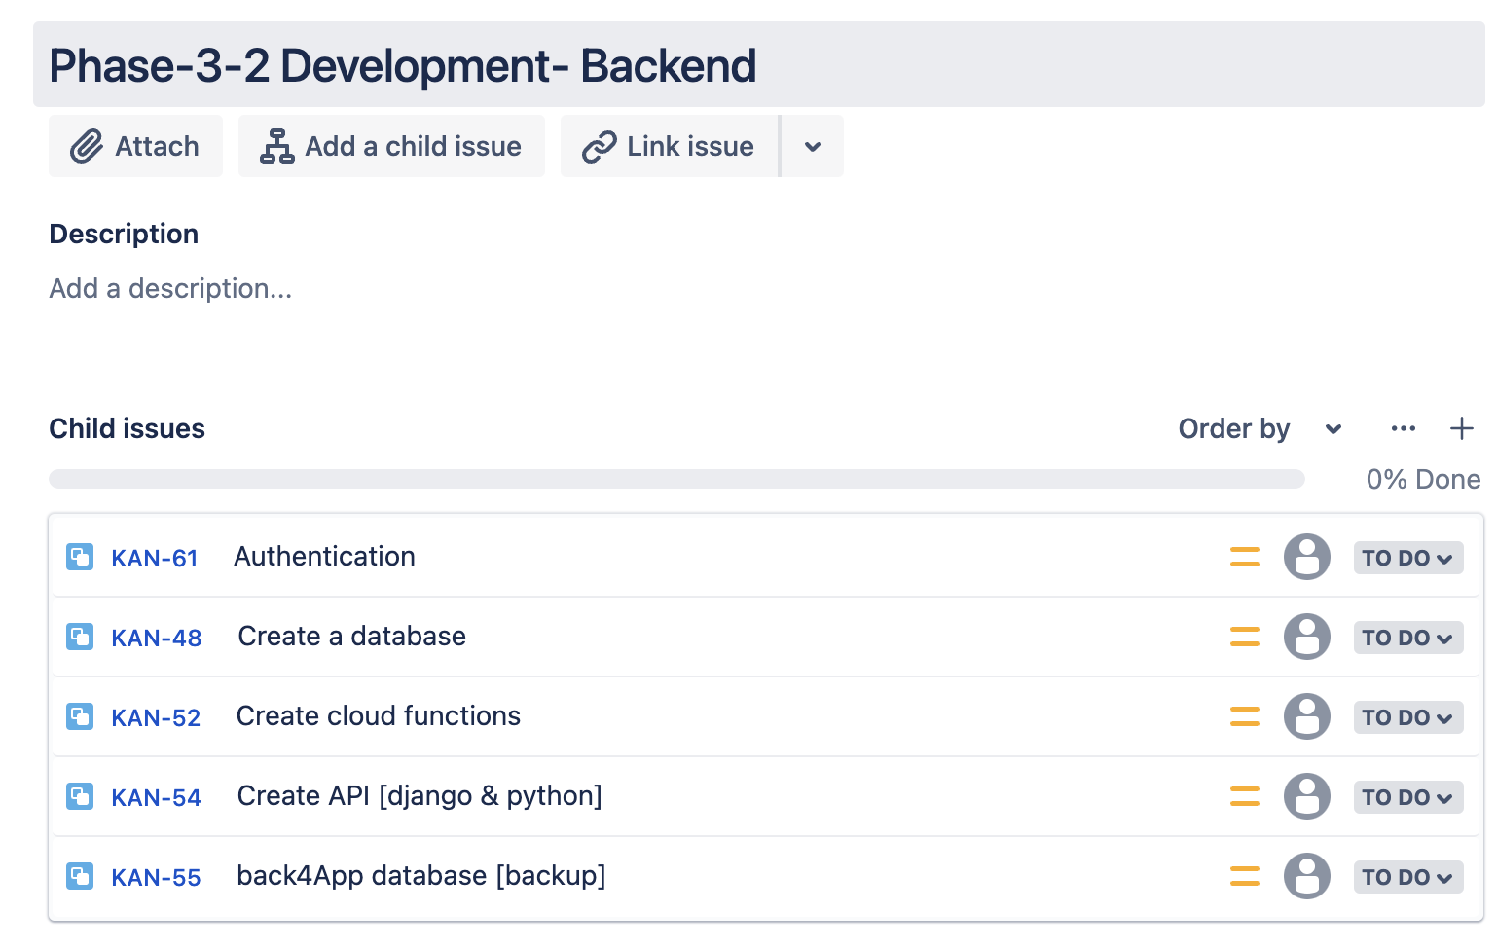
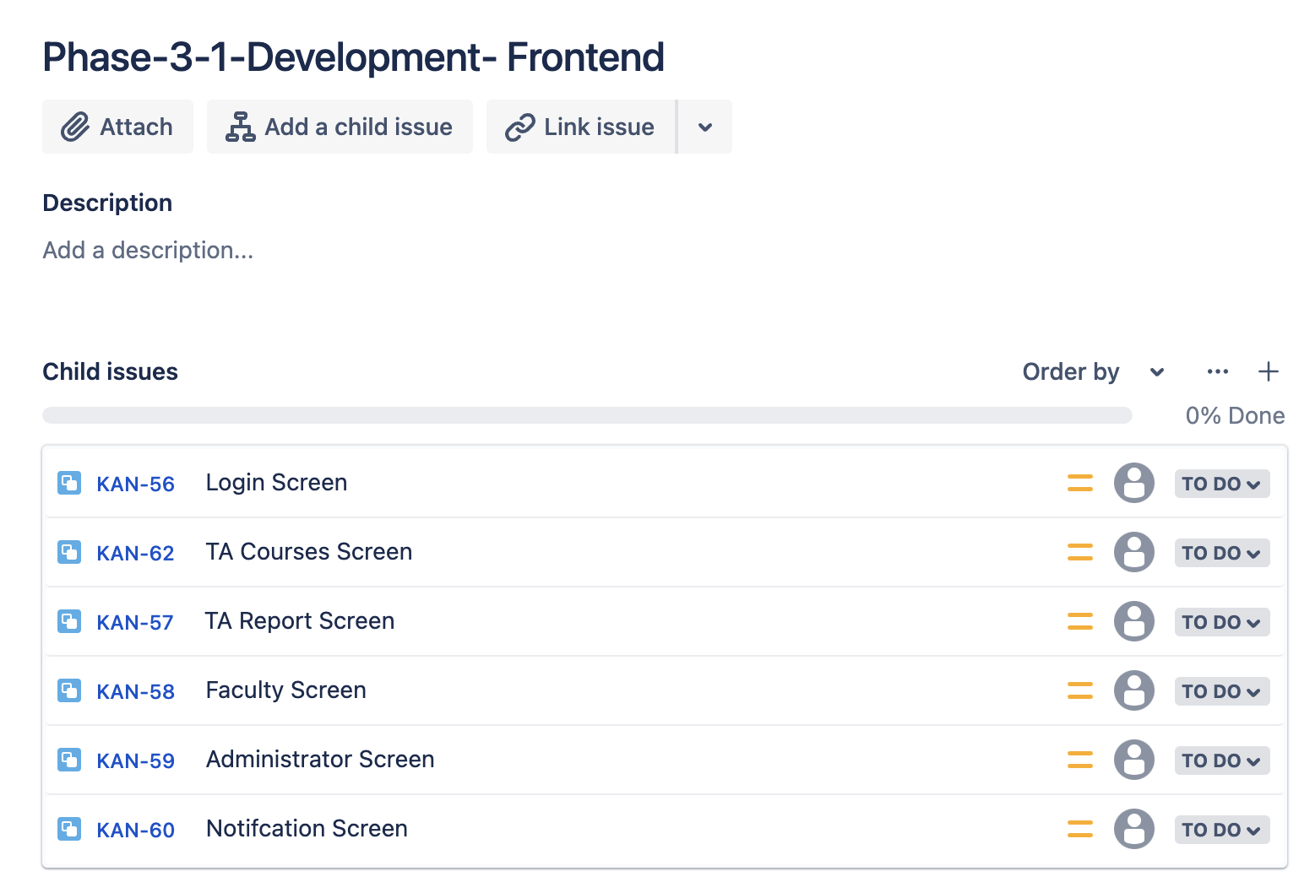
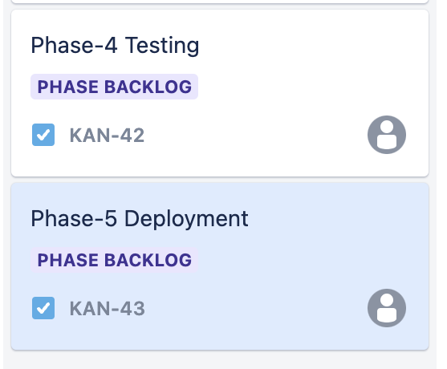

Slide 5
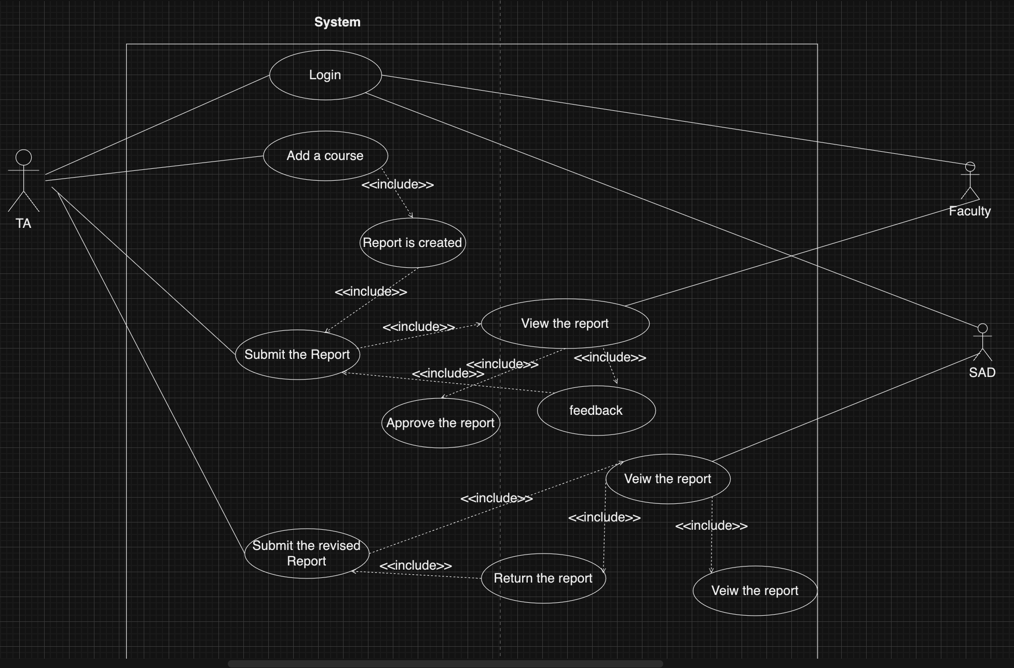
Use-case Diagram

Slide 6
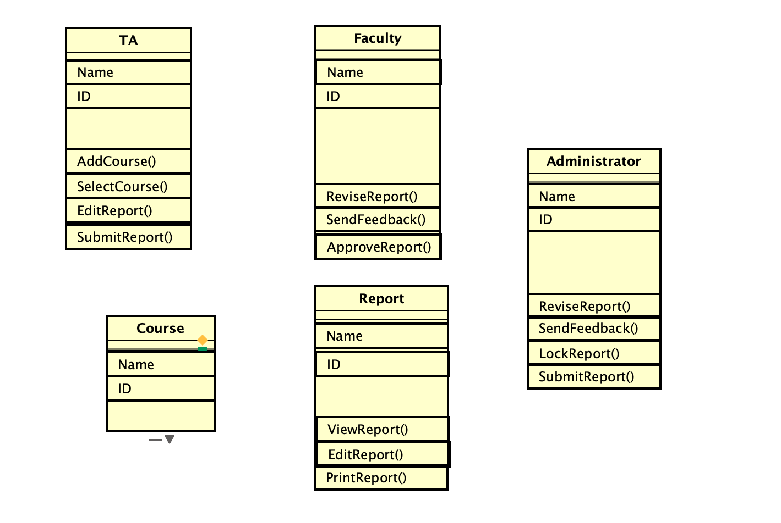
Class Diagram

Slide 7
Plan for Next Week
Task | Member | Work Hours
Use-Case diagram (UI description) | Youssef | 0:30
Class diagram model(database structure) | Merci | 0:30
(UI design) login screen | Youssef | 0:30
(UI design) TA course screen | Merci | 0:30
(UI design) TA report screen | Merci | 0:30
(UI design) Faculty screen | Youssef | 0:30
(UI design) Administration screen | Youssef
(UI design) Notification screen | Merci & Youssef | 0:30
 | Total time: | 4:00

Slide 8
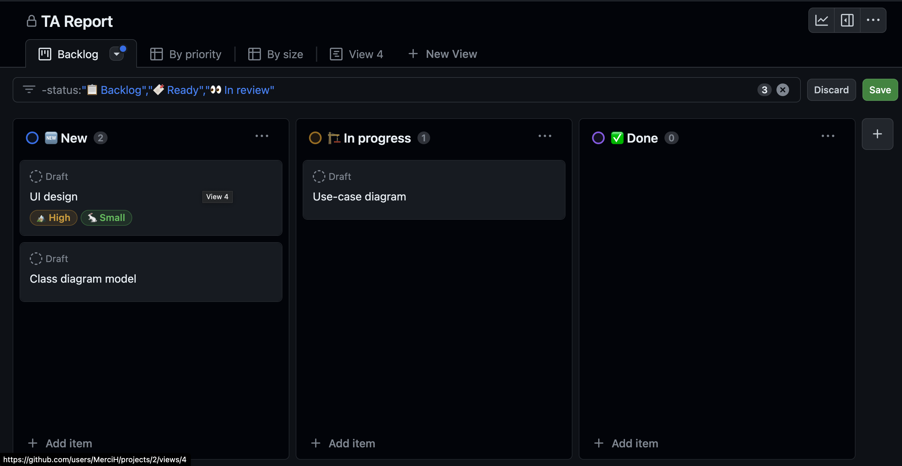
Phase Task Board

Slide 9
Issues & Risks (*if any)
Problem
Cause
Possible Solution
Deadline
Issues: Analyze what is hindering your progress. It is an existing problem that is causing delays.
Risks: Try to plan for possible problems that could cause delays.
This should help you analyze your current progress and prepare for future problems

